Slide 1
Stack Frame
Stack Frame
H
0x0
dummy
Address of exit()
&bss
&pr gadget
Address of system()
0x8
&bss
0x0
&pppr gadget
Address of read()
SFP of main()
buf[256]
…
4B
H
0x0
AAAA
Address of exit()
/bin/sh\00
&pr gadget
Address of system()
0x8
/bin/sh\00
0x0
&pppr gadget
Address of read()
AAAA
AAAAAAA ….. AAA
…
4B
4B
4B
4B
4B
4B
4B
4B
4B
4B
4B
8B
8B
4B
4B
4B
4B
4B
4B
4B
4B
4B
4B
256B
256B
L
L

Slide 2
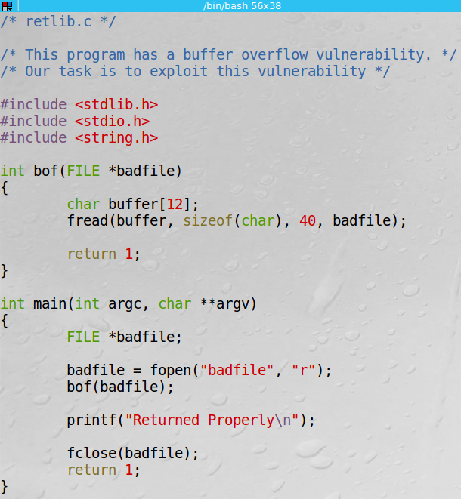
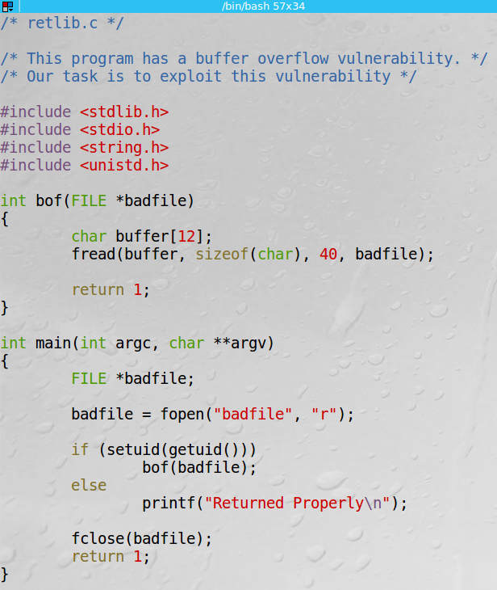
setuid()와 getuid() 함수를 사용하기 위한 헤더파일

